Slide 1

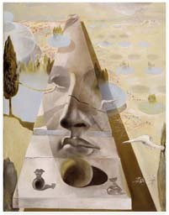
Lecture 7
Multi-view geometry
The SFM problem
Affine SFM
Perspective SFM
Self-calibration
Applications
Reading:
[HZ] Chapter 10 “3D reconstruction of cameras and structure” Chapter 18 “N-view computational methods”
Chapter 19 “Auto-calibration”
[FP] Chapter 13 “projective structure from motion” [Szelisky] Chapter 7 “Structure from motion”
Silvio Savarese
Lecture 7 -
31-Jan-18

Slide 2

Affine structure from motion
(simpler problem)
World point X_{j}
Image 1
^{x}ij
Image i
From the mxn observations x_{ij}, estimate:
m projection matrices M_{i} (affine cameras)
n 3D points X_{j}

Slide 3
Affine structure from motion
(simpler problem)
World point X_{j}
Image 1
^{x}ij
Image i
For the affine case (in Euclidean space)
x_{ij} = A_{i}X _{j} + b_{i} [Eq. 4]
2x1
2x3
3x1
2x1

Slide 4
The Affine Structure-from-Motion Problem
Two approaches:
Algebraic approach (affine epipolar geometry; estimate F; cameras; points)
Factorization method

Slide 5
A factorization method –
Tomasi & Kanade algorithm
C. Tomasi and T. KanadeShape and motion from image streams under orthography: A factorization method. IJCV, 9(2):137-154, November 1992.
Data centering
Factorization

Slide 6
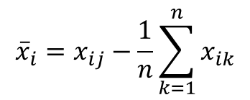
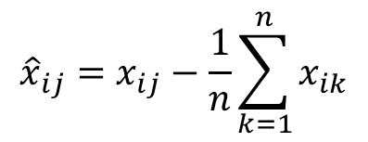
A factorization method - Centering the data
Centering: subtract the centroid of the image points
$${\hat{x}}_{ij}=x_{ij}−\frac{1}{n}\sum_{k=1}^{n}{x_{ik}}$$
x_{i}
[Eq. 6]
X_{k}
x_{i}
^{x}ik
$${\overline{x}}_{i}=x_{ij}−\frac{1}{n}\sum_{k=1}^{n}{x_{ik}}$$
[Eq. 5]
Image i

Slide 7
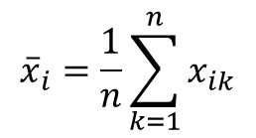
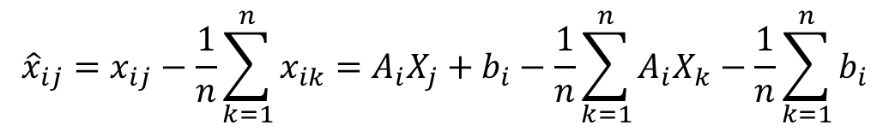
A factorization method - Centering the data
Centering: subtract the centroid of the image points
$${\hat{x}}_{ij}=x_{ij}−\frac{1}{n}\sum_{k=1}^{n}{x_{ik}}=A_{i}X_{j}+b_{i}−\frac{1}{n}\sum_{k=1}^{n}{A_{i}X_{k}−\frac{1}{n}\sum_{k=1}^{n}{b_{i}}}$$
[Eq. 6]
^{x}ik
= A_{i}X_{k} + b_{i}
[Eq. 4]
X_{k}
x_{i}
^{x}ik
$${\overline{x}}_{i}=\frac{1}{n}\sum_{k=1}^{n}{x_{ik}}$$
[Eq. 5]

Slide 8
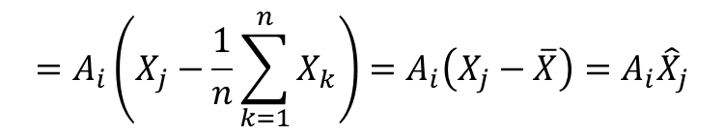
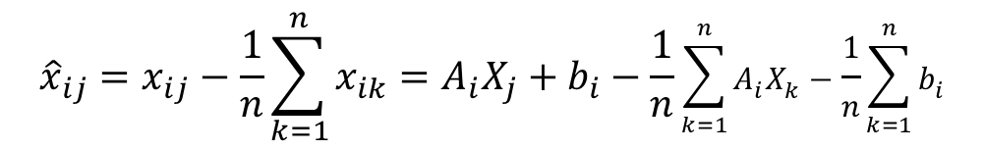
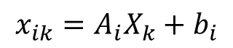
A factorization method - Centering the data
Centering: subtract the centroid of the image points
$${\hat{x}}_{ij}=x_{ij}−\frac{1}{n}\sum_{k=1}^{n}{x_{ik}}=A_{i}X_{j}+b_{i}−\frac{1}{n}\sum_{k=1}^{n}{A_{i}X_{k}−\frac{1}{n}\sum_{k=1}^{n}{b_{i}}}$$
[Eq. 6]
$$=A_{i}\left(X_{j}−\frac{1}{n}\sum_{k=1}^{n}{X_{k}}\right)=A_{i}\left(X_{j}−\overline{X}\right)=A_{i}{\hat{X}}_{j}$$
[Eq. 4]
$$x_{ik}=A_{i}X_{k}+b_{i}$$
[Eq. 8]
X_{k}
X
1
n
x
X = ∑X_{k}
i
^{x}ik
[Eq. 7]
^{n} k=1
Centroid of 3D points
1
n
x_{i} = ∑x_{ik}
n
k=1

Slide 9
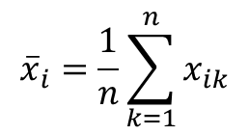
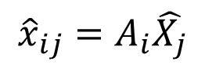
A factorization method - Centering the data
Thus, after centering, each normalized observed point is related to the 3D point by
$${\hat{x}}_{ij}=A_{i}\hat{X_{j}}$$
[Eq. 8]
X_{k}
X
1
n
x
X = ∑X_{k}
i
^{x}ik
[Eq. 7]
^{n} k=1
Centroid of 3D points
$${\overline{x}}_{i}=\frac{1}{n}\sum_{k=1}^{n}{x_{ik}}$$

Slide 10
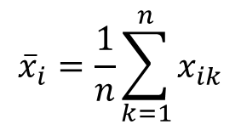
A factorization method - Centering the data
If the centroid of points in 3D = center of the world reference system
[Eq. 9]
xˆ_{ij} = A_{i}X^{ˆ} _{j} = A_{i}X _{j}
X_{k}
X
1
n
x
X = ∑X_{k}
i
^{x}ik
[Eq. 7]
^{n} k=1
Centroid of 3D points
$${\overline{x}}_{i}=\frac{1}{n}\sum_{k=1}^{n}{x_{ik}}$$

Slide 11
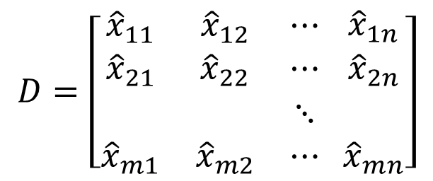
A factorization method - factorization
Let’s create a 2m × n data (measurement) matrix:
$$D=\left[\begin{matrix}{\hat{x}}_{11} & {\hat{x}}_{12} & ⋯ \\ {\hat{x}}_{21} & {\hat{x}}_{22} & ⋯ \\ \begin{aligned} \\ {\hat{x}}_{m1}\end{aligned} & \begin{aligned} \\ {\hat{x}}_{m2}\end{aligned} & \begin{aligned}⋱ \\ ⋯\end{aligned}\end{matrix} \begin{matrix}{\hat{x}}_{1n} \\ {\hat{x}}_{2n} \\ \begin{aligned} \\ {\hat{x}}_{mn}\end{aligned}\end{matrix}\right]$$
cameras (2 m )
points (n )
Each x^{ˆ}_{ij}
entry is a 2x1 vector!

Slide 12
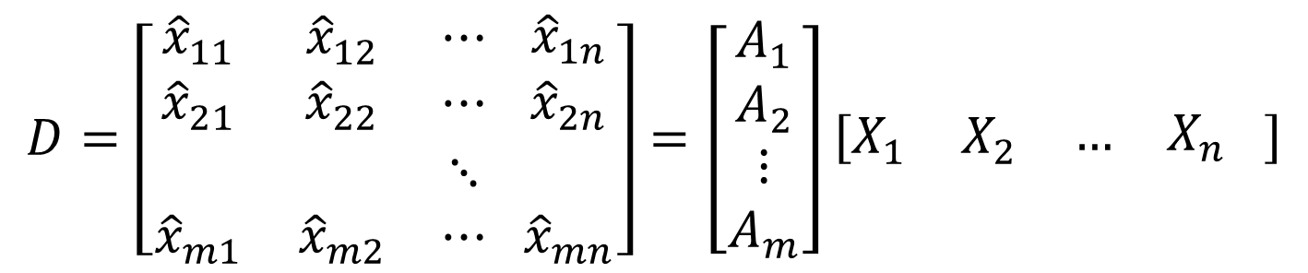
A factorization method - factorization
Let’s create a 2m × n data (measurement) matrix:
$$D=\left[\begin{matrix}{\hat{x}}_{11} & {\hat{x}}_{12} & ⋯ \\ {\hat{x}}_{21} & {\hat{x}}_{22} & ⋯ \\ \begin{aligned} \\ {\hat{x}}_{m1}\end{aligned} & \begin{aligned} \\ {\hat{x}}_{m2}\end{aligned} & \begin{aligned}⋱ \\ ⋯\end{aligned}\end{matrix} \begin{matrix}{\hat{x}}_{1n} \\ {\hat{x}}_{2n} \\ \begin{aligned} \\ {\hat{x}}_{mn}\end{aligned}\end{matrix}\right]=\left[\begin{matrix}A_{1} \\ A_{2} \\ \begin{aligned}⋮ \\ A_{m}\end{aligned}\end{matrix}\right]\left[\begin{matrix}X_{1} & X_{2} & \begin{matrix}… & X_{n}\end{matrix}\end{matrix} \right]$$
(2 m × n)
points (3 × n )
S
M
cameras (2 m × 3)
[Eq. 10]
Each x^{ˆ}_{ij}
entry is a 2x1 vector!
A_{i} is 2x3 and X_{j} is 3x1
The measurement matrix D = M S has rank 3
(it’s a product of a 2mx3 matrix and 3xn matrix)

Slide 13
Factorizing the Measurement Matrix
How to factorize D?
Measurements D | = | Motion M | × | Structure S
 |  |  |  | n
 |  |  |  | D = MS
n |  | 3
2m
3

Slide 14
Factorizing the Measurement Matrix
By computing the Singular value decomposition of D!
D
U
W
_{V}T
2m
=
×
×
n
n
n
n
n

Slide 15
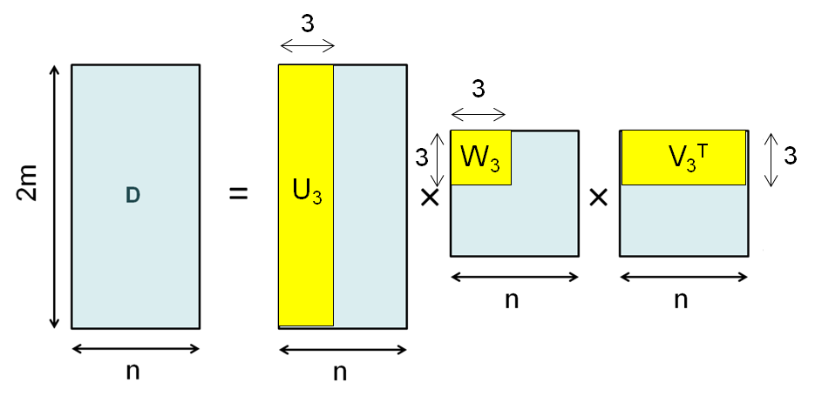
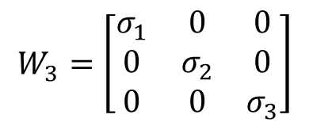
Factorizing the Measurement Matrix
Since rank (D)=3, there are only 3 non-zero singular values σ₁ , σ₂ and σ₃
$$W_{3}=\left[\begin{matrix}σ_{1} & 0 & 0 \\ 0 & σ_{2} & 0 \\ 0 & 0 & σ_{3}\end{matrix}\right]$$
Where
[Eq. 11]

Slide 16
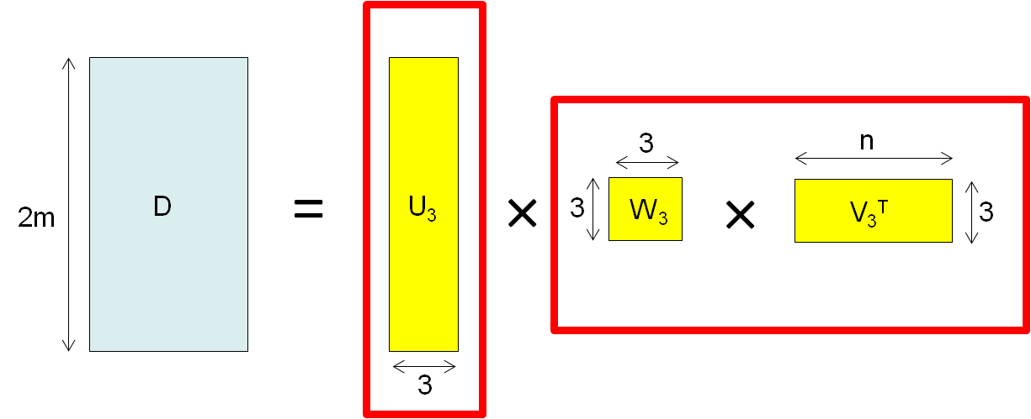
Factorizing the Measurement Matrix

Slide 17
Factorizing the Measurement Matrix
S = structure
M = Motion (cameras)
D = U₃ W₃ V₃^{T} = U₃ (W₃ V₃^{T}) = M S
[Eq. 12]

Slide 18

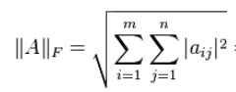
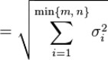
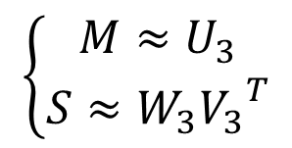
Factorizing the Measurement Matrix
D = U₃ W₃ V₃^{T} = U₃ (W₃ V₃^{T}) = M S [Eq. 12]
What is the issue here?
D has rank>3 because of:
measurement noise
affine approximation
Theorem: When D has a rank greater than 3, U W V^{T}
is the best
3 3 3
possible rank- ₃ approximation of D in the sense of the Frobenius norm.
D = U W V^{T}
$$\left\{\begin{matrix}M≈U_{3} \\ S≈W_{3}{V_{3}}^{T}\end{matrix}\right.$$
3 3 3

Slide 19
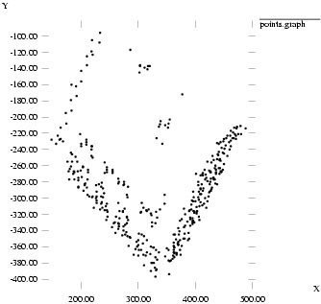
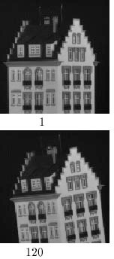
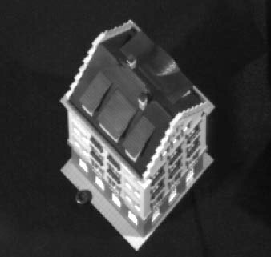
Reconstruction results
C. Tomasi and T. Kanade. Shape and motion from image streams under orthography: A factorization method. IJCV, 9(2):137-154, November 1992.

Slide 20
Affine Ambiguity
D
M
=
S

Slide 21
Affine Ambiguity
D
M
=
×
H
_{H}-1
S
M*
S*
The decomposition is not unique. We get the same D by applying the transformations:
M* = M H S* = H⁻¹S
where H is an arbitrary 3x3 matrix describing an affine transformation
Additional constraints must be enforced to resolve this ambiguity

Slide 22
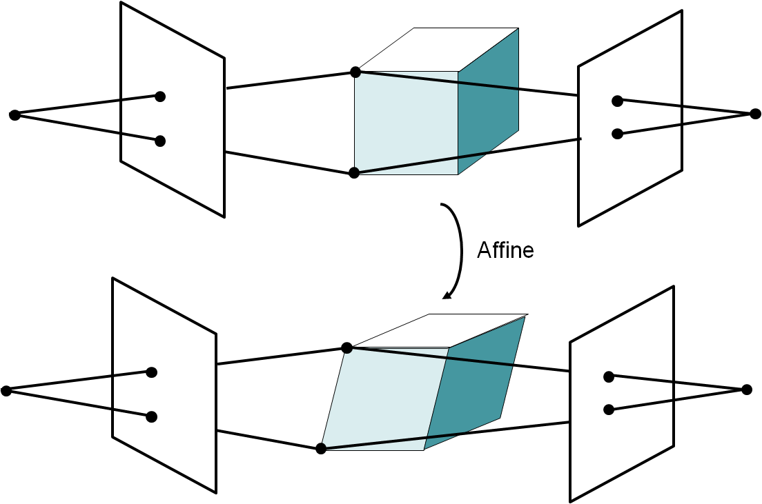

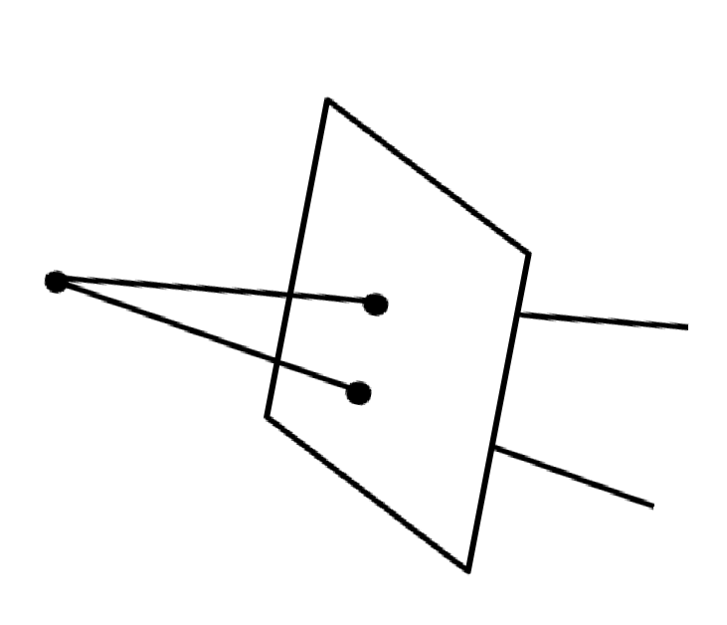

Affine Ambiguity
S
A
A’
A* = A H
S* = H⁻¹S
A’* = A’ H

Slide 23
The Affine Structure-from-Motion Problem
Given m images of n fixed points X_{j} we can write
x_{ij} = A_{i}X _{j} + b_{i}
for i = 1, …,m and j = 1, … ,n
N. of cameras N. of points
Problem: estimate m matrices A_{i}, m matrices b_{i}
and the n positions X_{j} from the m×n observations x_{ij} .
How many equations and how many unknown?
2m × n equations in 8m + 3n - 8 unknowns

Slide 24
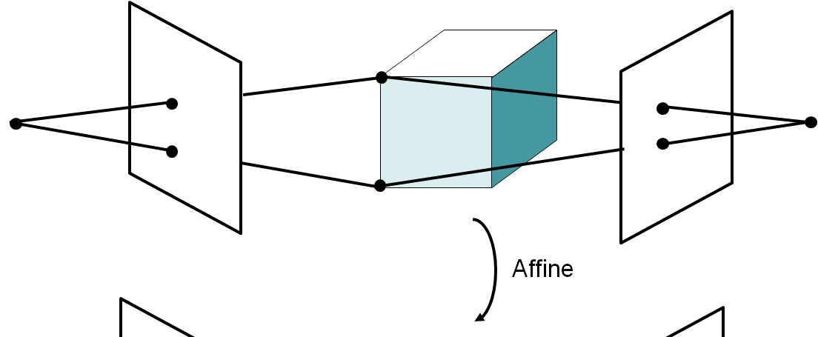
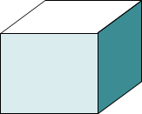
Similarity Ambiguity
The scene is determined by the images only up a similarity transformation (rotation, translation and scaling)
This is called metric reconstruction
Similarity
The ambiguity exists even for (intrinsically) calibrated cameras
For calibrated cameras, the similarity ambiguity is the only ambiguity
[Longuet-Higgins ’81]

Slide 25
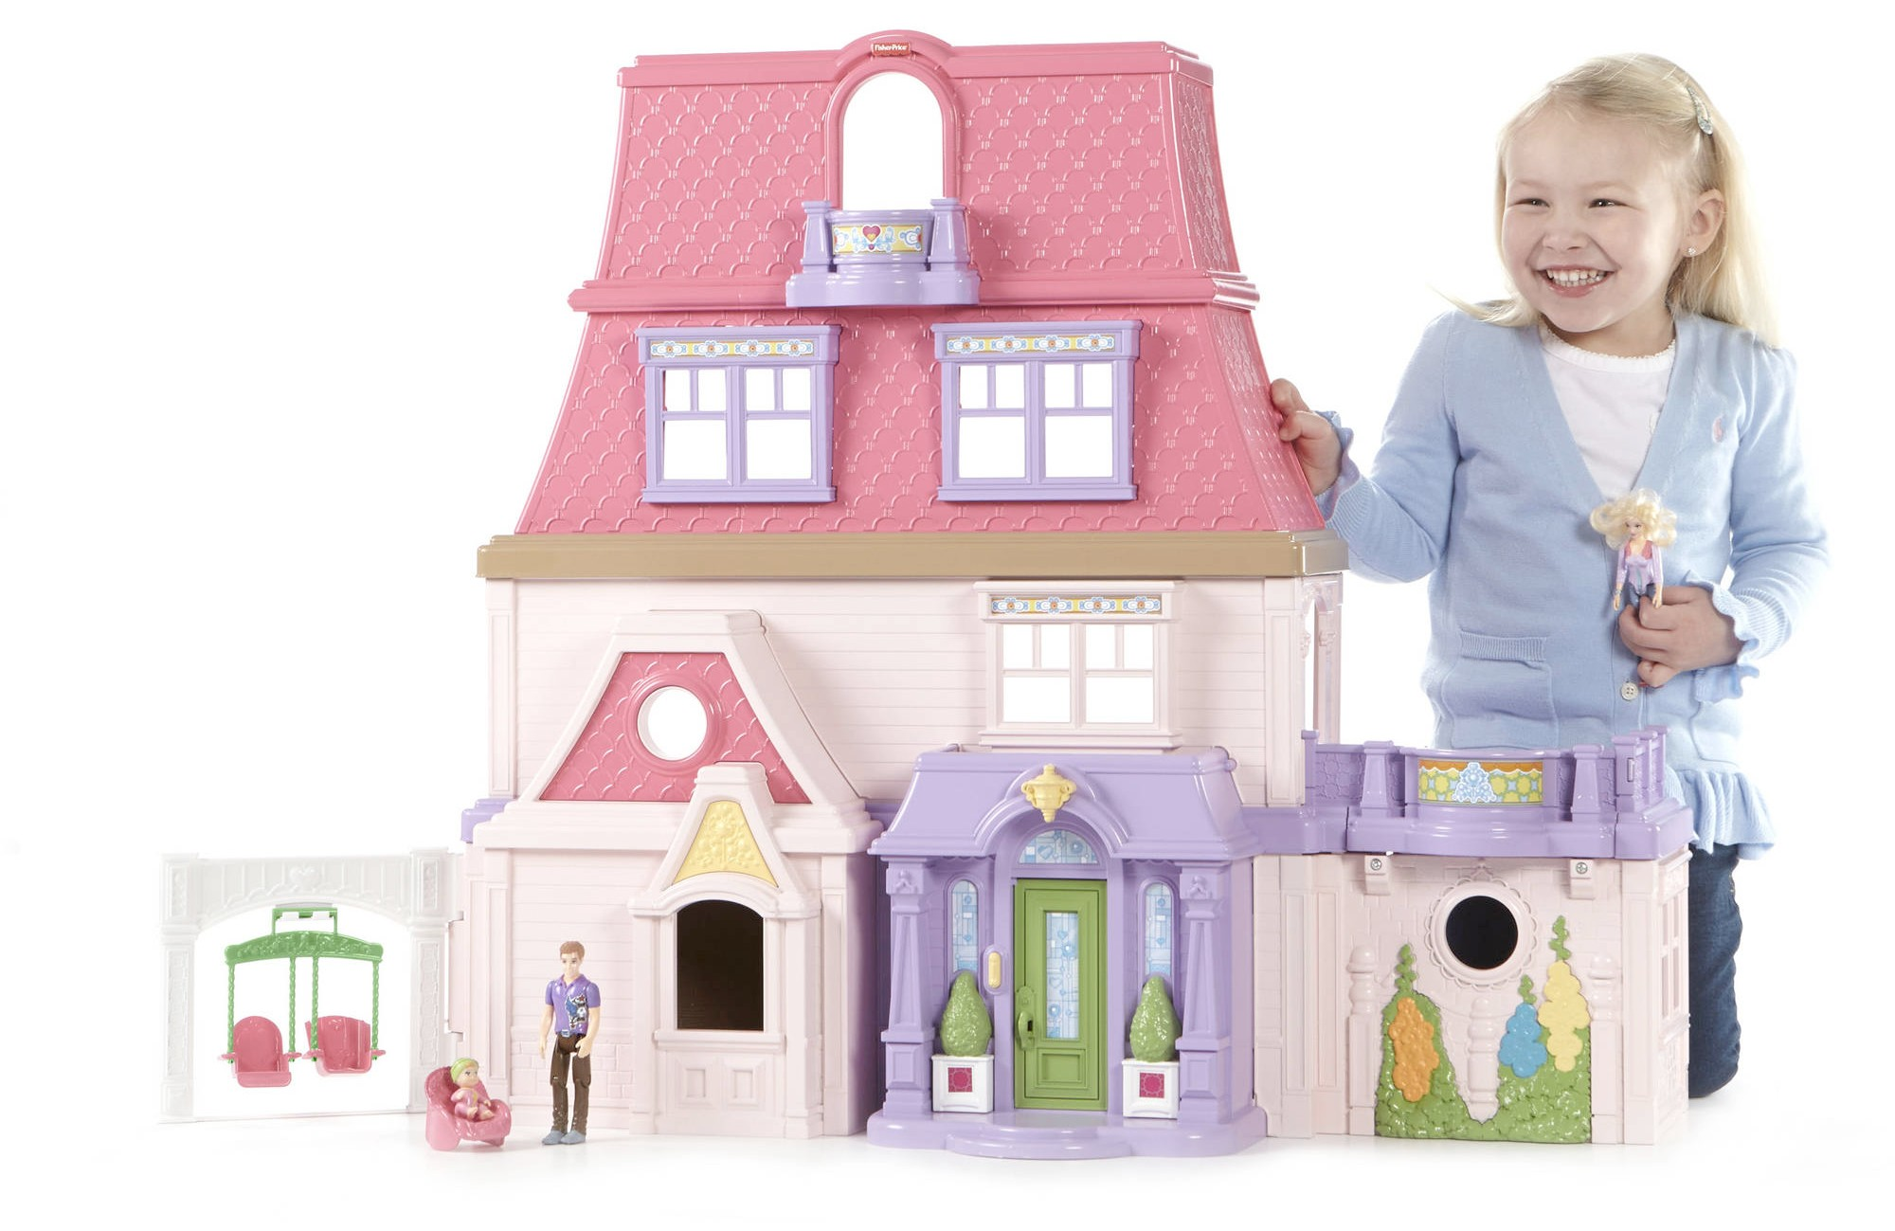
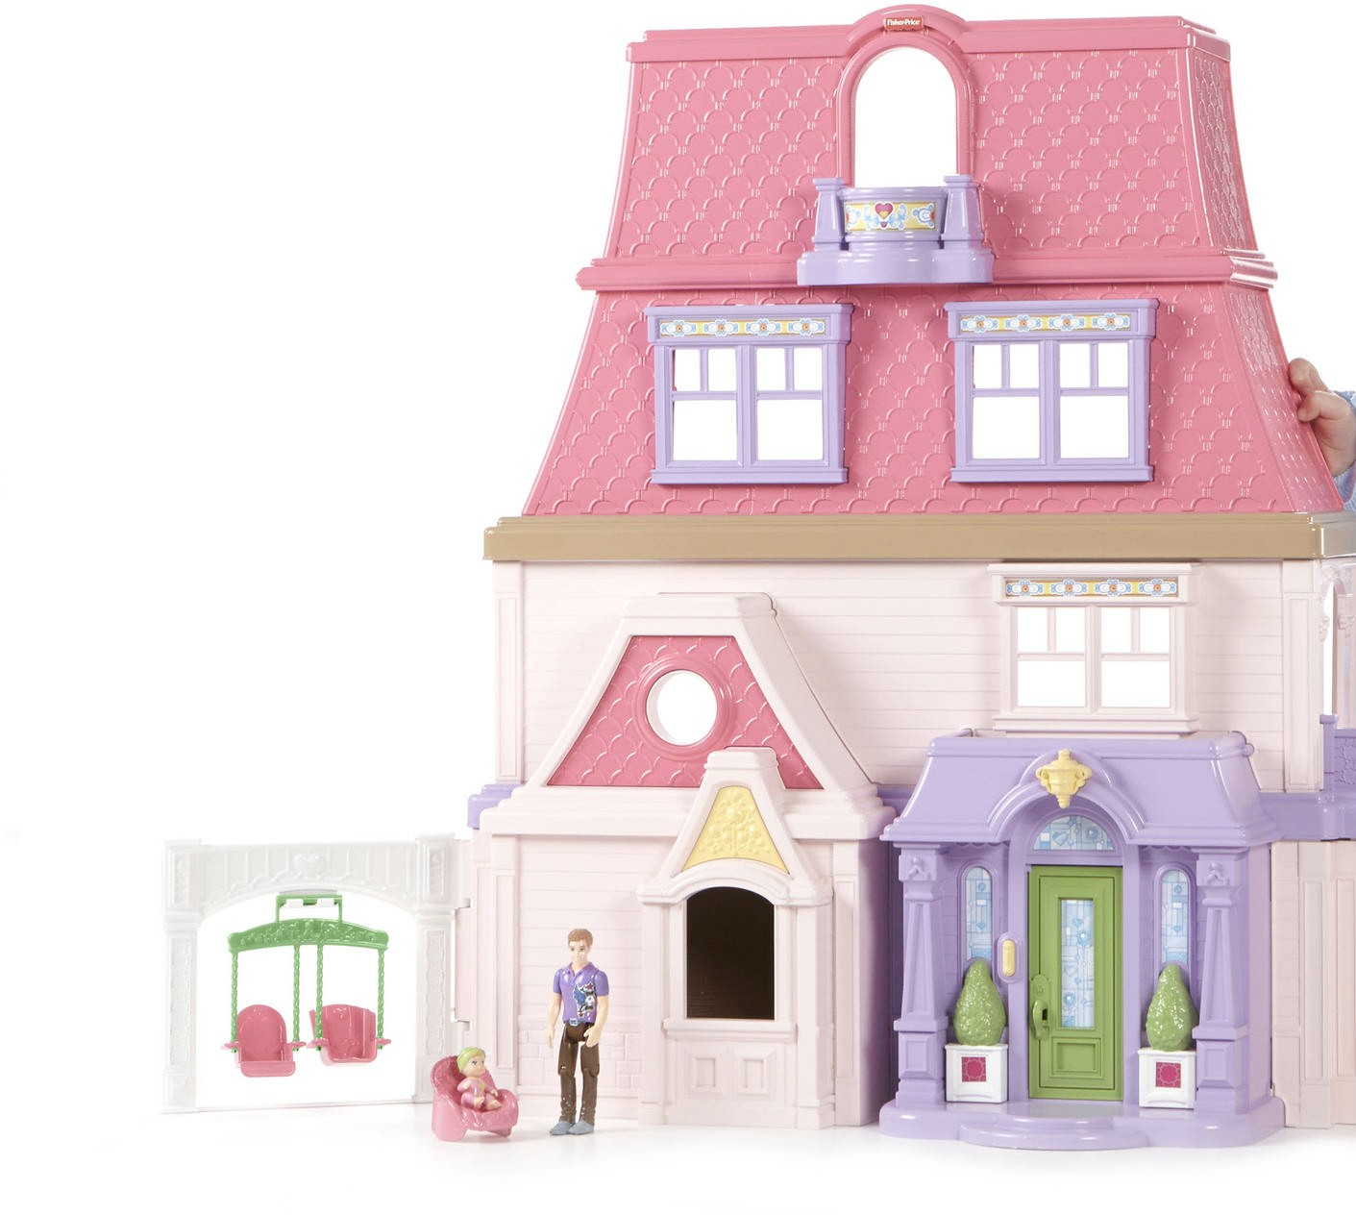
Similarity Ambiguity
It is impossible, based on the images alone, to estimate the absolute scale of the scene

Slide 26
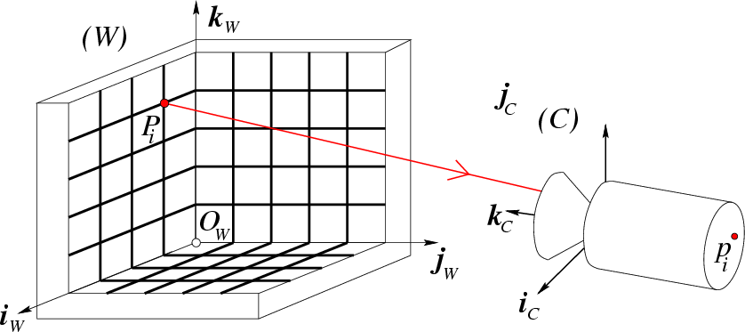

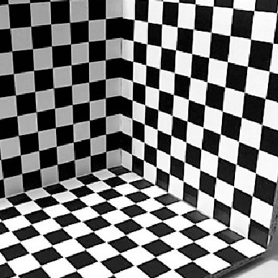
Resolving the similarity ambiguity
Calibration rig
image
p_{i}
jj_{CC}
While calibrating a camera, we make assumptions about the geometry of the world

Slide 27
Lecture 7
Multi-view geometry
The SFM problem
Affine SFM
Perspective SFM
Self-calibration
Applications
Silvio Savarese
Lecture 7 -
31-Jan-18

Slide 28
Structure from motion problem
X_{j}
^{x}1j
M_{m} ^{x}mj
M₁
^{x}2j
M₂
From the mxn observations x_{ij}, estimate:
m projection matrices M_{i}= motion
n 3D points X_{j} = structure

Slide 29
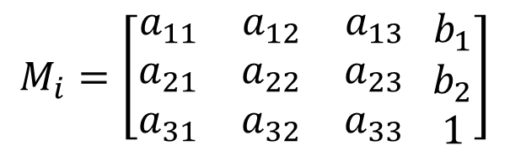
Structure from motion problem
X_{j}
^{x}1j
M_{m} ^{x}mj
M₁
^{x}2j
M₂
$$M_{i}=\left[\begin{matrix}a_{11} & a_{12} & a_{13} \\ a_{21} & a_{22} & a_{23} \\ a_{31} & a_{32} & a_{33}\end{matrix} \begin{matrix}b_{1} \\ b_{2} \\ 1\end{matrix}\right]$$
m cameras M₁… M_{m}

Slide 30
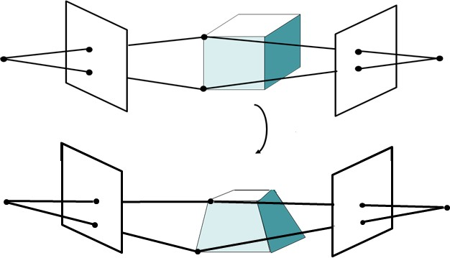
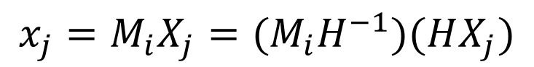
Structure from Motion Ambiguities
x _{j}
In the general case (nothing is known) the ambiguity is expressed by an arbitrary 4X4 projective transformation
Projective
x _{j}
x _{j} = M_{i} X_{j}
= K_{i}[R_{i} T_{i} ]
M_{i}
_{M H}−1
H X _{j}
j
$$x_{j}=M_{i}X_{j}=(M_{i}H^{−1})(HX_{j})$$

Slide 31
The Structure-from-Motion Problem
Given m images of n fixed points X_{j} we can write
x_{ij} = M_{i} X_{j}
for i = 1, …,m and j = 1, … ,n
N. of cameras N. of points
Problem: estimate m 3×4 matrices M_{i} and n positions X_{j} from m×n obvesrvations x_{ij} .
If the cameras are not calibrated, cameras and points can only be recovered up to a 4x4 projective (where the 4x4 projective is defined up to scale)
Given two cameras, how many points are needed?
How many equations and how many unknown?
2m × n equations in 11m+3n – 15 unknowns

Slide 32
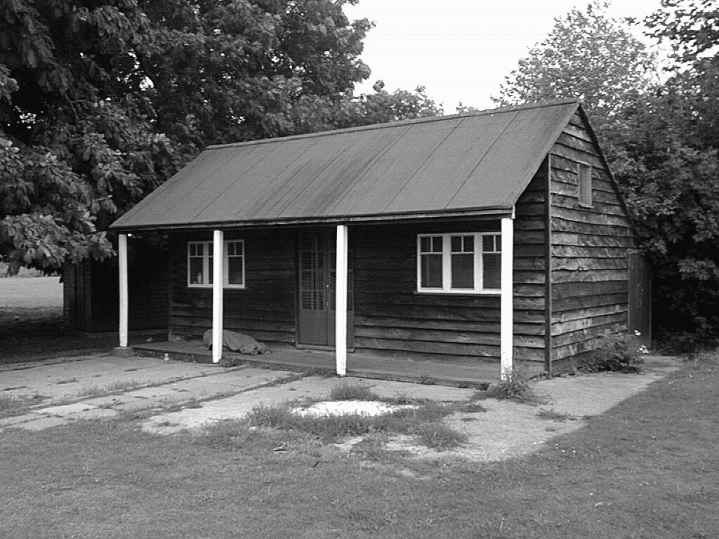
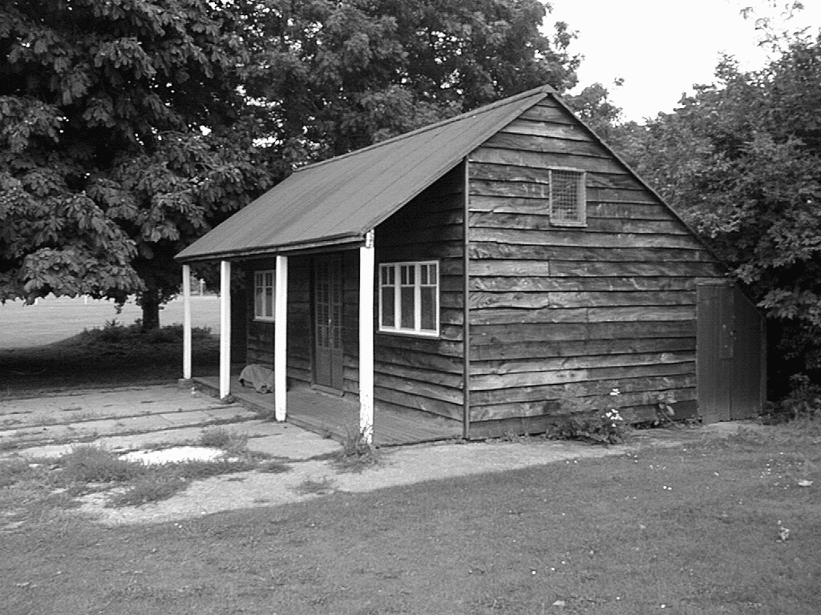
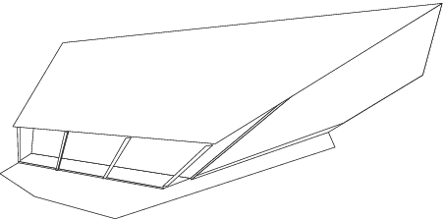
Projective Ambiguity
S =
R. Hartley and A. Zisserman, Multiple View Geometry in Computer Vision, 2nd edition, 2003

Slide 33
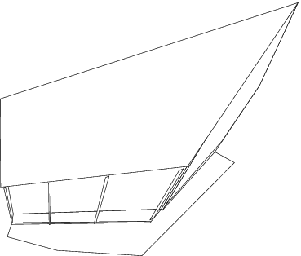
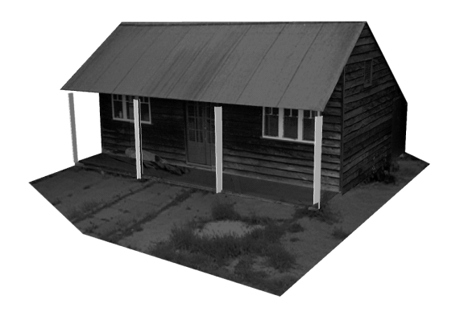
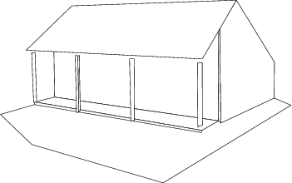
Metric reconstruction (upgrade)
The problem of recovering the metric reconstruction from the perspective one is called self-calibration

Slide 34
Structure-from-Motion methods
1. Recovering structure and motion up to perspective ambiguity
Algebraic approach (by fundamental matrix)
Factorization method (by SVD)
Bundle adjustment
2. Resolving the perspective ambiguity

Slide 35
Algebraic approach (2-view case)
Compute the fundamental matrix F from two views
Use F to estimate projective cameras
Use these cameras to triangulate and estimate points in 3D

Slide 36
Algebraic approach (2-view case)
X_{j}
^{x}1 j
x_{1 j} = M₁ X_{j}
x_{2 j} = M₂ X_{j}
For j = 1, … ,n
N. of points
M₁
^{x}2 j
M₂
From at least 8 point correspondences, compute F associated to camera 1 and 2

Slide 37
Algebraic approach (2-view case)
1. Compute the fundamental matrix F from two views (eg. 8 point algorithm)
2. Use F to estimate projective cameras
3. Use these cameras to triangulate and estimate points in 3D

Slide 38
Algebraic approach (2-view case)
X_{j}
x_{1 j} = M₁ X_{j}
x_{2 j} = M₂ X_{j}
For j = 1, … ,n
N. of points
^{x}1j
M
1
^{x}2j
M₂
Because of the projective ambiguity, we can always apply a projective transformation H such that:
= [I 0] M H
= [A b]
M H
−1
−1
1
[Eq. 3]
2
Canonical perspective camera
[Eq. 4]

Slide 39
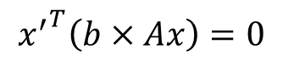
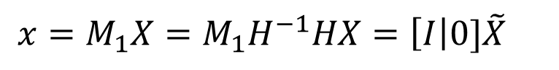
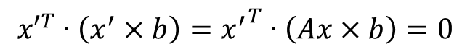
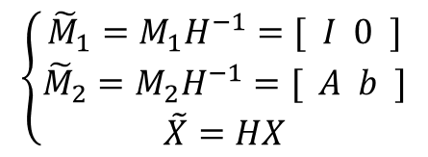
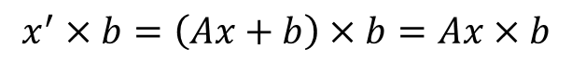
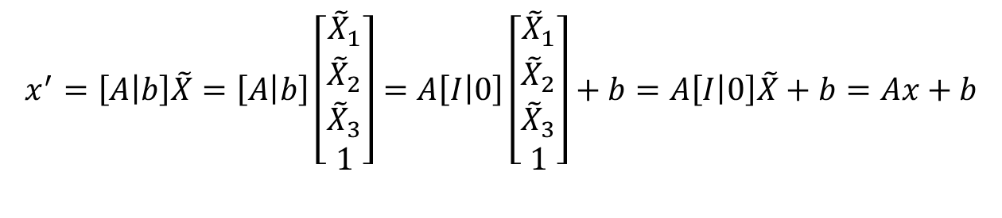
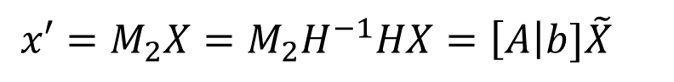
Algebraic approach (2-view case)
Call X a generic 3D point X_{ij}
Call x and x’ the corresponding observations to camera 1 and respectively
[Eq. 6]
[Eqs. 5]
$$\left\{\begin{matrix}{\tilde{M}}_{1}=M_{1}H^{−1}=[ I 0 ] \\ {\tilde{M}}_{2}=M_{2}H^{−1}=[ A b ] \\ \tilde{X}=HX\end{matrix}\right.$$
$$x=M_{1}X=M_{1}H^{−1}HX=\left[I\right|0]\tilde{X}$$
$$x′=M_{2}X=M_{2}H^{−1}HX=\left[A\right|b]\tilde{X}$$
$$x^{′}=\left[A | b\right]\tilde{X}=\left[A | b\right]\left[\begin{matrix}{\tilde{X}}_{1} \\ {\tilde{X}}_{2} \\ \begin{aligned}{\tilde{X}}_{3} \\ 1\end{aligned}\end{matrix}\right]=A\left[I | 0\right]\left[\begin{matrix}{\tilde{X}}_{1} \\ {\tilde{X}}_{2} \\ \begin{aligned}{\tilde{X}}_{3} \\ 1\end{aligned}\end{matrix}\right]+b=A\left[I | 0\right]\tilde{X}+b=Ax+b$$
[Eq. 7]
$$x^{′}×b=\left(Ax+b\right)×b=Ax×b$$
[Eq. 8]
[Eq. 9]
$${x′}^{T}∙\left(x^{′}×b\right)={x^{′}}^{T}∙\left(Ax×b\right)=0$$
$${x^{′}}^{T}\left(b×Ax\right)=0$$
[Eq. 10]

Slide 40
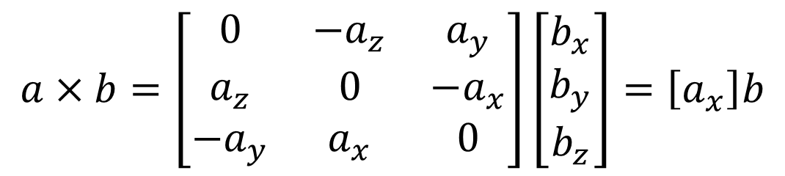
Cross product as matrix multiplication
$$a×b=\left[\begin{matrix}0 & −a_{z} & a_{y} \\ a_{z} & 0 & −a_{x} \\ −a_{y} & a_{x} & 0\end{matrix}\right]\left[\begin{matrix}b_{x} \\ b_{y} \\ b_{z}\end{matrix}\right]=\left[a_{x}\right]b$$

Slide 41

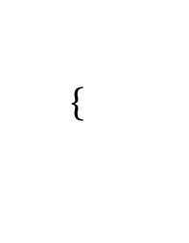
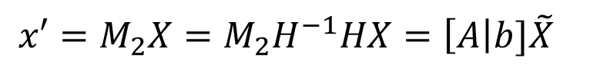
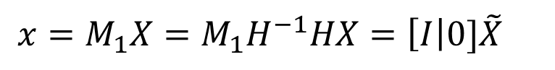

Algebraic approach (2-view case)
$$\left\{\begin{matrix}{\tilde{M}}_{1}=M_{1}H^{−1}=[ I 0 ] \\ {\tilde{M}}_{2}=M_{2}H^{−1}=[ A b ] \\ \tilde{X}=HX\end{matrix}\right.$$
$$x=M_{1}X=M_{1}H^{−1}HX=\left[I\right|0]\tilde{X}$$
[Eqs. 5]
[Eq. 6]
$$x′=M_{2}X=M_{2}H^{−1}HX=\left[A\right|b]\tilde{X}$$
….
x′^{T} (b × Ax) = 0
[Eq. 10]
x′^{T}F x = 0
F =[b×]A
x′
T
[b×]A x = 0
fundamental matrix!

Slide 42



Compute cameras
Compute b:
Let’s consider the product F b
$$x^{′}Fx=0$$
$$F=\left[b_{x}\right]A=b×A$$
[Eq. 11]
[Eq. 12]
Since F is singular, we can compute b as least sq. solution of F b = 0, with |b|=1 using SVD
Using a similar derivation, we have that b^{T} F = 0^{[Eq. 12-bis]}
$$F∙b=\left[b_{x}\right]A∙b=b×A∙b=0$$

Slide 43





Compute cameras
$${x′}^{T}Fx=0$$
$$F=\left[b_{x}\right]A$$
$$\left\{\begin{matrix}Fb=0 \\ b^{T}F=0\end{matrix}\right.$$
[Eq. 12]
[Eq. 12-bis]
[Eq. 11]
Compute A:
Define:A’ = –[b×] F
Let’s verify that [b×]A' is equal to F :
Indeed:
$$\left[b_{x}\right]A^{′}=−\left[b_{x}\right]\left[b_{x}\right]F=−\left(bb^{T}−{\left|B\right|}^{2}I\right)F=−bb^{T}F+{\left|b\right|}^{2}F=0+1∙F=F$$
[Eq. 13]
Thus, A = A’ = –[b×] F
$${\tilde{M}}_{1}=[ I 0 ]$$
$${\tilde{M}}_{2}=[−\left[b_{x}\right]F b]$$
[Eqs. 14]

Slide 44



Interpretation of b
$${x′}^{T}Fx=0$$
$$F=\left[b_{x}\right]A$$
$$\left\{\begin{matrix}Fb=0 \\ b^{T}F=0\end{matrix}\right.$$
[Eq. 12]
[Eq. 12-bis]
[Eq. 11]
What’s b??

Slide 45


Epipolar Constraint [lecture 5]
X
x₁
x₂
e₁
e₂
O₁
O₂
F x₂ is the epipolar line associated with x₂ (l₁ = F x₂) F^{T} x₁ is the epipolar line associated with x₁ (l₂ = F^{T} x₁) F is singular (rank two)
F e₂ = 0 and F^{T} e₁ = 0 F is 3x3 matrix; 7 DOF

Slide 46







Interpretation of b
$${x′}^{T}Fx=0$$
$$F=\left[b_{x}\right]A$$
$$\left\{\begin{matrix}Fb=0 \\ b^{T}F=0\end{matrix}\right.$$
[Eq. 11]
b is an epipole!
$${\tilde{M}}_{1}=[ I 0 ]$$
$${\tilde{M}}_{2}=[ −\left[b_{x}\right]F b ]$$
[Eq. 15]
$${\tilde{M}}_{1}=[ I 0 ]$$
$${\tilde{M}}_{2}=[ −\left[e_{x}\right]F e ]$$
[Eq. 16]
HZ, page 254
PF, page 288

Slide 47
Algebraic approach (2-view case)
Compute the fundamental matrix F from two views (eg. 8 point algorithm)
Use F to estimate projective cameras
3. Use these cameras to triangulate and estimate
points in 3D

Slide 48








Triangulation
$${\tilde{X}}_{j}$$
$$x_{1j}={\tilde{M}}_{2}{\tilde{X}}_{j}$$
^{x}1j
$$x_{2j}={\tilde{M}}_{1}{\tilde{X}}_{j}$$
^{x}2j
$${\tilde{M}}_{1}$$
$${\tilde{M}}_{2}$$
$${\tilde{M}}_{1}=[I 0 ]$$
$$→ {\tilde{X}}_{j} for i=1,…,n$$
$${\tilde{M}}_{2}=[ −\left[e_{x}\right]F e ]$$
3D points can be computed from camera matrices via SVD (see page 312 of HZ for details)

Slide 49





Algebraic approach: the N-views case
$${\tilde{X}}_{j}$$
^{x}hj
$${\tilde{M}}_{h}$$
$${\tilde{M}}_{1}$$
^{x}1j
^{x}kj
$${\tilde{M}}_{k}$$
- From I_{k} and I_{h}
$$→{\tilde{M}}_{k},{\tilde{M}}_{h},{\tilde{X}}_{[k,h]}$$
3D points associated to point correspondences available between I_{k} and I_{h}
- Pairwise solutions may be combined together using bundle adjustment

Slide 50
Structure-from-Motion Algorithms
Algebraic approach (by fundamental matrix)
Factorization method (by SVD)
Bundle adjustment

Slide 51
Limitations of the approaches so far
Factorization methods assume all points are visible. This not true if:
occlusions occur
failure in establishing correspondences
Algebraic methods work with 2 views

Slide 52


Bundle adjustment
Non-linear method for refining structure and motion
Minimizes re-projection error
$$E\left(M,X\right)=\sum_{i=1}^{m}{\sum_{j=1}^{n}{D{(x_{ij}^{},M_{I}^{}X_{j}^{})}^{2}}}$$
Reconstructed X_{j}
ground truth X_{j}
M₁X_{j}
^{x}1j
^{x}mj
M_{m}X_{j}
M₂X_{j}
^{x}2j
O₁
O_{m}
O₂

Slide 53

General Calibration Problem
$$E\left(M,X\right)=\sum_{i=1}^{m}{\sum_{j=1}^{n}{D{(x_{ij}^{},M_{I}^{}X_{j}^{})}^{2}}}$$
parameters
measurements
D is the nonlinear mapping
Newton Method
Levenberg-Marquardt Algorithm
Iterative, starts from initial solution
May be slow if initial solution far from real solution
Estimated solution may be function of the initial solution
Newton requires the computation of J, H
Levenberg-Marquardt doesn’t require the computation of H

Slide 54
Bundle adjustment
Advantages
Handle large number of views
Handle missing data
Limitations
Large minimization problem (parameters grow with number of views)
Requires good initial condition
Used as the final step of SFM (i.e., after the factorization or algebraic approach)
Factorization or algebraic approaches provide a initial solution for optimization problem

Slide 55
Lecture 7
Multi-view geometry
The SFM problem
Affine SFM
Perspective SFM
Self-calibration
Applications
Silvio Savarese
Lecture 7 -
31-Jan-18

Slide 56

Self-calibration
Self-calibration is the problem of recovering the metric reconstruction from the perspective (or affine) reconstruction
We can self-calibrate the camera by making some assumptions about the cameras

Slide 57
Self-calibration
[HZ] Chapters 19 “Auto-calibration”
Several approaches:
Use single-view metrology constraints (lecture 4)
Direct approach (Kruppa Eqs) for 2 views
Algebraic approach
Stratified approach

Slide 58
Inject information about the camera during the bundle adjustment optimization
For calibrated cameras, the similarity ambiguity is the
only ambiguity
[Longuet-Higgins ’81]

Slide 59
Lecture 7
Multi-view geometry
The SFM problem
Affine SFM
Perspective SFM
Self-calibration
Applications

Slide 60


Structure from motion problem
Courtesy of Oxford Visual Geometry Group
Lucas & Kanade, 81 Chen & Medioni, 92 Debevec et al., 96 Levoy & Hanrahan, 96 Fitzgibbon & Zisserman, 98
Triggs et al., 99 Pollefeys et al., 99 Kutulakos & Seitz, 99
Levoy et al., 00
Hartley & Zisserman, 00 Dellaert et al., 00 Rusinkiewic et al., 02 Nistér, 04
Brown & Lowe, 04 Schindler et al, 04 Lourakis & Argyros, 04 Colombo et al. 05
Golparvar-Fard, et al. JAEI 10
Pandey et al. IFAC , 2010 Pandey et al. ICRA 2011 Microsoft’s PhotoSynth Snavely et al., 06-08 Schindler et al., 08 Agarwal et al., 09
Frahm et al., 10

Slide 61

Reconstruction and texture mapping
M. Pollefeys et al 98---

Slide 62















































































































Incremental reconstruction of construction sites
Initial pair – 2168 & Complete Set 62,323 points, 160 images
Golparvar-Fard. Pena-Mora, Savarese 2008
62

Slide 63

Reconstructed scene + Site photos
63

Slide 64

Reconstructed scene + Site photos

Slide 65



Results and applications
Noah Snavely, Steven M. Seitz, Richard Szeliski, "Photo tourism: Exploring photo collections in 3D," ACM Transactions on Graphics (SIGGRAPH Proceedings),2006,

Slide 66
Next lecture
Fitting and Matching

Slide 67
Appendix

Slide 68
Direct approach
We use the following results:
A relationship that maps conics across views
Concept of absolute conic and its relationship to K
The Kruppa equations

Slide 69




Projections of conics across views
$$X^{T}C_{w}X=0$$
[Eq. 1]
$$X=\left[\begin{matrix}X_{1} \\ X_{2} \\ \begin{aligned}X_{3} \\ 1\end{aligned}\end{matrix}\right]$$
Π _{w}
C
O_{w}
w
I’
I
C '
3x3 matrix
C
[Eq. 2]
$${[e′]}_{x}{C′}^{−1}{[e′]}_{x}=FC^{−1}F^{T}$$
O’
O

Slide 70



Projection of absolute conics across views
From lecture 4, [HZ] page 210, sec. 8.5.1
Π∞
C∞
O_{w}
ω
ω '
$${[e′]}_{x}{ω′}^{−1}{[e′]}_{x}=Fω^{−1}F^{T}$$
[Eq. 3]
[Eq. 4]
[Eq. 5]
$$ω={(KK^{T})}^{T}$$
$$ω′={(K′{K′}^{T})}^{T}$$
O’
O

Slide 71

Kruppa equations
[Faugeras et al. 92]
From [HZ] page 471
$$\left(\begin{matrix}u_{2}^{T}K′{K′}^{T}u_{2} \\ {−u}_{1}^{T}K′{K′}^{T}u_{2} \\ u_{1}^{T}K′{K′}^{T}u_{1}\end{matrix}\right)×\left(\begin{matrix}σ_{1}^{T}v_{1}^{T}KK^{T}v_{1} \\ σ_{1}^{}σ_{2}^{}v_{1}^{T}KK^{T}v_{2} \\ σ_{2}^{2}v_{2}^{T}KK^{T}v_{2}\end{matrix}\right)=0$$
[Eq. 6]
where u_{i} , v_{i} and σ_{i} are the columns and singular values of SVD of F
These give us two independent constraints in the elements of K and K’

Slide 72



Kruppa equations
[Faugeras et al. 92]
$$\left(\begin{matrix}u_{2}^{T}K′{K′}^{T}u_{2} \\ {−u}_{1}^{T}K′{K′}^{T}u_{2} \\ u_{1}^{T}K′{K′}^{T}u_{1}\end{matrix}\right)×\left(\begin{matrix}σ_{1}^{T}v_{1}^{T}KK^{T}v_{1} \\ σ_{1}^{}σ_{2}^{}v_{1}^{T}KK^{T}v_{2} \\ σ_{2}^{2}v_{2}^{T}KK^{T}v_{2}\end{matrix}\right)=0$$
$$\frac{u_{2}^{T}KK^{T}u_{2}}{σ_{1}^{T}v_{1}^{T}KK^{T}v_{1}}=\frac{{−u}_{1}^{T}KK^{T}u_{2}}{σ_{1}^{}σ_{2}^{}v_{1}^{T}KK^{T}v_{2}}=\frac{u_{1}^{T}KK^{T}u_{1}}{σ_{2}^{2}v_{2}^{T}KK^{T}v_{2}}$$
[Eq. 7]
$$K^{′}=K=\left(\begin{matrix}f & 0 & 0 \\ 0 & f & 0 \\ 0 & 0 & 1\end{matrix}\right)$$
Let’s make the following assumption:
[Eq. 8]
[Eq. 9] α f ² + β f + γ = 0
f

Slide 73
Kruppa equations
[Faugeras et al. 92]
Powerful if we want to self-calibrate 2 cameras with unknown focal length
Limitations:
Work on a camera pair
Don’t work if R=0
[Eq. 10] [e']×ω ⁻¹ [e']×= F ω ⁻¹F^{T}
becomes trivial
F = [e']×
Since:

Slide 74
Self-calibration
[HZ] Chapters 19 “Auto-calibration”
Several approaches:
Use single-view metrology constraints (lecture 4)
Direct approach (Kruppa Eqs) for 2 views
Algebraic approach
Stratified approach

Slide 75





Algebraic approach
Multi-view approach
$$\left\{{\tilde{M}}_{i},{\tilde{X}}_{j}\right\}$$
Suppose we have a projective reconstruction
Let H be a homography such that:
$${\tilde{M}}_{1}=[I 0 ]$$
[Eq. 11]
First perspective camera is canonical:
i^{th} perspective reconstruction of the camera (known):
$${\tilde{M}}_{i}=[A_{i} b_{i} ]$$
[Eq. 12]
[Eq. 13]
$$\left(A_{i}−b_{i}p^{T}\right)K_{1}K_{1}^{T}{(A_{i}^{}−b_{i}^{}p^{T})}^{T}=K_{i}K_{i}^{T}$$
$$i=2…m$$
$$H=\left[\begin{matrix}K_{1} & 0 \\ −p^{T}K_{1} & 1\end{matrix}\right]$$
p is an unknown 3x1 vector
K₁…K_{m} are unknown
[Eq. 14]

Slide 76
Algebraic approach
Suppose we have a projective reconstruction Let H be a homography such that:
Multi-view approach
$${\tilde{M}}_{1}=[I 0 ]$$
[Eq. 11]
First perspective camera is canonical:
i^{th} perspective reconstruction of the camera (known):
$${\tilde{M}}_{i}=[A_{i} b_{i} ]$$
[Eq. 12]
[Eq. 13]
$$\left(A_{i}−b_{i}p^{T}\right)K_{1}K_{1}^{T}{(A_{i}^{}−b_{i}^{}p^{T})}^{T}=K_{i}K_{i}^{T}$$
$$i=2…m$$
How many unknowns?
3 from p
5 m from K₁…K_{m}
5 independent equations [per view]
How many equations?

Slide 77

Algebraic approach
Multi-view approach
Suppose we have a projective reconstruction
Let H be a homography such that:
$${\tilde{M}}_{1}=[I 0 ]$$
[Eq. 11]
First perspective camera is canonical:
i^{th} perspective reconstruction of the camera (known):
$${\tilde{M}}_{i}=[A_{i} b_{i} ]$$
[Eq. 12]
Assume all camera matrices are identical: K₁ = K₂ … = K_{m}
[Eq. 15]
$$\left(A_{i}−b_{i}p^{T}\right)K_{1}K_{1}^{T}{(A_{i}^{}−b_{i}^{}p^{T})}^{T}=K_{i}K_{i}^{T}$$
$$i=2…m$$
How many unknowns?
3 from p
5 from K
5 independent equations [per view]
How many equations?
We need at least 3 views to solve the self-calibration problem

Slide 78
Algebraic approach
Art of self-calibration:
Use assumptions on Ks to generate enough equations on the unknowns
Condition | N. Views
Constant internal parameters | 3
Aspect ratio and skew known Focal length and offset vary | 4
Skew =0, all other parameters vary | 8
Issue: the larger is the number of view,
the harder is the correspondence problem
Bundle adjustment helps!

Slide 79
SFM problem - summary
Estimate structure and motion up perspective transformation
Algebraic
factorization method
bundle adjustment
Convert from perspective to metric (self-calibration)
Bundle adjustment
** or **
1. Bundle adjustment with self-calibration constraints

